Slide 1
CIS-598 Project Unknown
Haoran An

Slide 2

Overview
Current Status
Class Diagram
Sequence Diagram
Testing
Demo
Questions

Slide 3
Current Status
Battle System (√)
Test Map (√)
Weapon System (√)
Elements System (⍻)
Still need to work on Unity about time
Skill System (X) Only one
Enemy AI (X)
Random System (X)

Slide 4

Class Diagrams(Player)

Slide 5
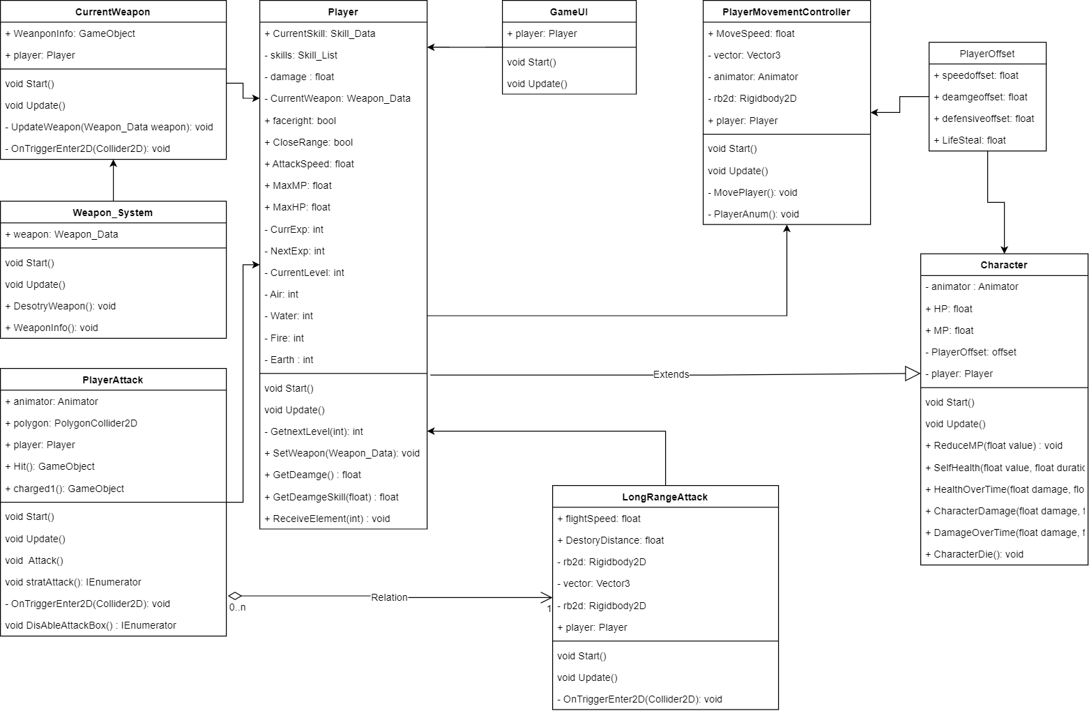

Slide 6
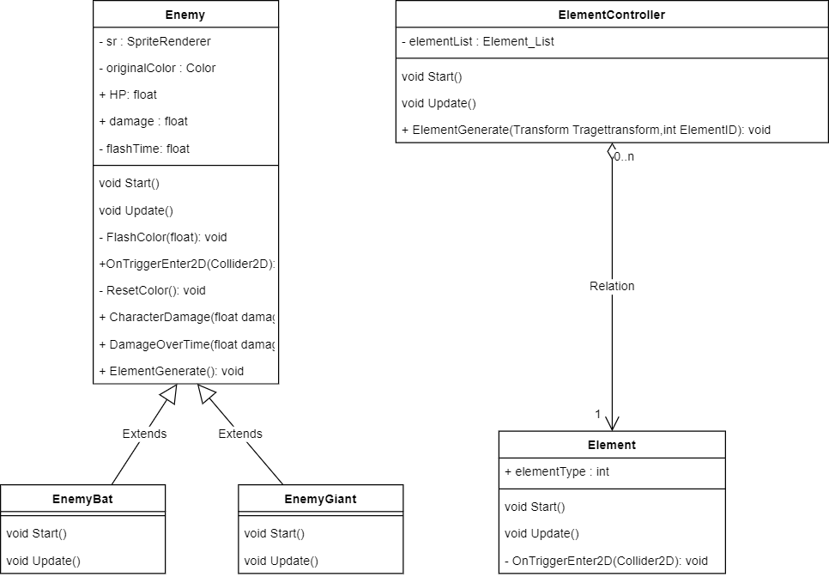
Class Diagrams(Enemy)

Slide 7
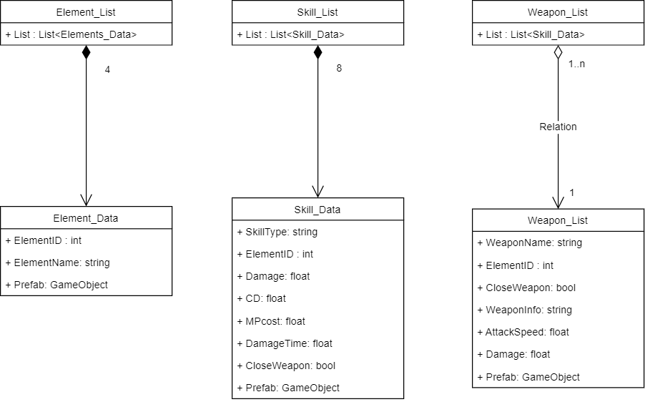
Class Diagrams(Resources)

Slide 8
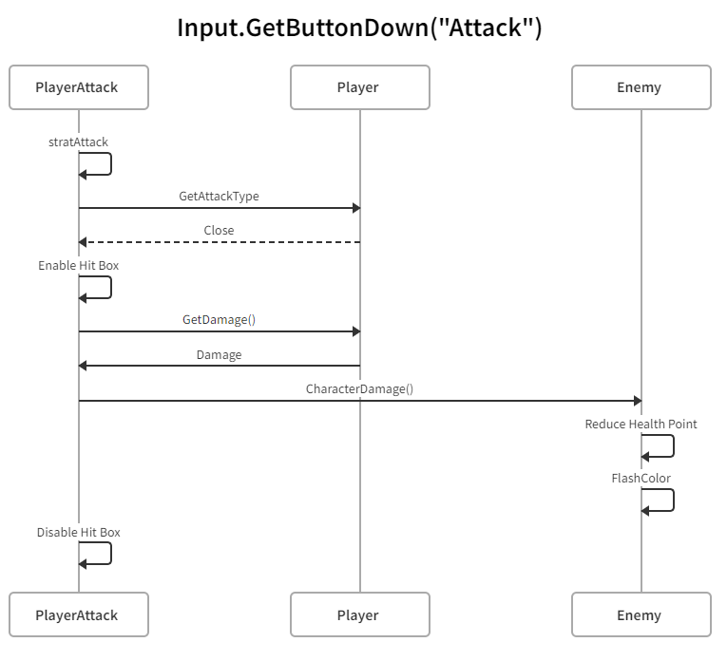
Sequence Diagrams(Close Attack)

Slide 9
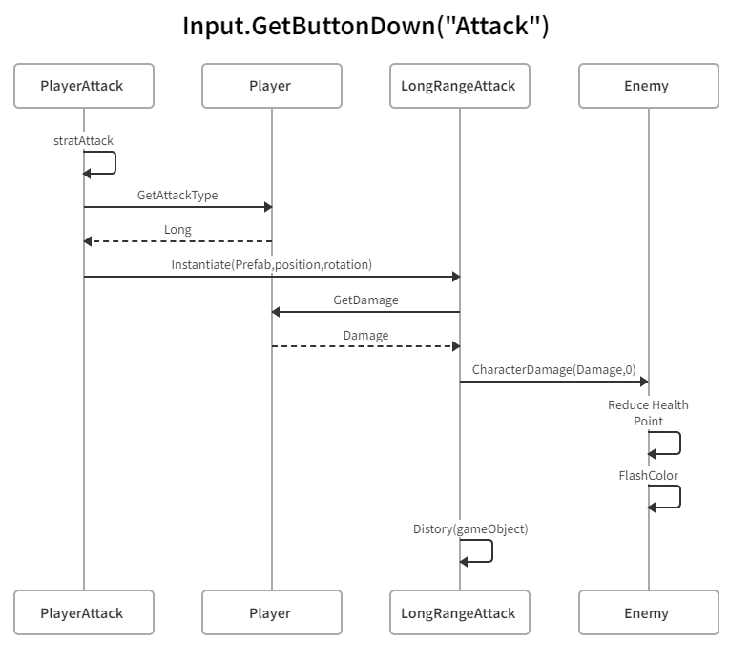
Sequence Diagrams(Long Range Attack)

Slide 10
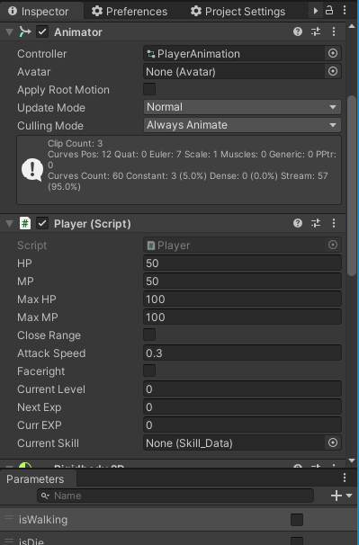
Testing
Test Unit support by Unity
Inspector, Parameters and Game Windows

Slide 11
Testing
Case 1 Player Behaviors
Tasks
Using WASD as input
Left Click Mouse to Attack
If Health is less than 0 Player Die
Goal
Player Move
Player Attack, successful Enable Hit Box at the right time
Play right Animation
Frozen all input after Player Die

Slide 12
Testing
Case 2 Player Attack and Weapon System
Tasks
Left click Mouse to Attack
Move the Player to another Weapon
Left click Mouse to Attack
Goal
Enemy reduce Health Point
Player change to Long-Range Attack
Generate Bullets

Slide 13
Testing
Case 3 Player Skill
Tasks
Right click Mouse to use Skill
Goal
Generate Skill
Enemy reduces Health Points over the time

Slide 14
Testing
Case 4 Enemy Die
Tasks
Left Click Mouse to Attack, Until Enemy Die
Pick up the Elements generated from Enemy
Goal
Enemy Objects destroy
Elements generate and not overlapping
Player increase EXP and attributes

Slide 15

Demo

Slide 16

Question

